Slide 1
CONTINUA MECHANICS Strain and Strain Rate Tensors
Robert Nigmatulin
nigmar@ocean.ru

Slide 2
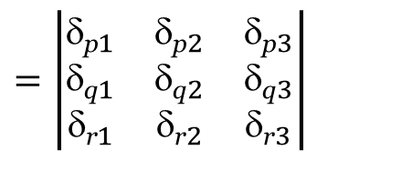
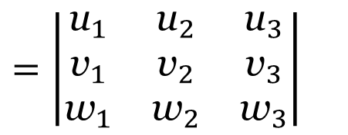
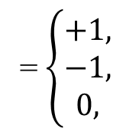
The volume of the parallelepiped
spanned by vectors u = u_{i} e_{i}, v = v_{j} e_{j} , w = w_{k}e_{k}
→
→
→
→
→
→
u v w
V_{uvw} = det
The volume of the rectangular parallelepiped
spanned by basis vectors
u = e_{p} = δ_{pi} e_{i} = δ_{p1}e₁ + δ_{p2}e₂ + δ_{p3}e₃ , v = e_{q} = δ_{qj} e_{j} , w = e_{r} = δ_{rk} e_{k}
→
→
→
→
→
→
→
→
→
→
→
$$=\left|\begin{matrix}{\text{u}}_{1} & {\text{u}}_{2} & {\text{u}}_{3} \\ {\text{v}}_{1} & {\text{v}}_{2} & {\text{v}}_{3} \\ {\text{w}}_{1} & {\text{w}}_{2} & {\text{w}}_{3}\end{matrix}\right|$$
$$=\left|\begin{matrix}{\text{}\text{p}}_{1} & {\text{}\text{p}}_{2} & {\text{}\text{p}}_{3} \\ {\text{}\text{q}}_{1} & {\text{}\text{q}}_{2} & {\text{}\text{q}}_{3} \\ {\text{}\text{r}}_{1} & {\text{}\text{r}}_{2} & {\text{}\text{r}}_{3}\end{matrix}\right|$$
V_{uvw} =
= ε_{pqr}
= ε_{pqr}
= $\left\{\begin{aligned}+1, \\ −1, \\ 0, \end{aligned}\right.$
$$\text{permutation}\text{ (}\text{p}\text{, }\text{q}\text{, }\text{r}\text{) = (1, 2, 3), (2, 3, 1), (3, 1, 2),}$$
e_{p}, e_{q} , e_{r}
→
→
→
$$\text{permutation} \text{(}\text{p}\text{, }\text{q}\text{, }\text{r}\text{) = (1, 3, 2), (3, 2, 1), (2, 3, 1),}$$
$$\text{combimations} \text{with} \text{repited} \text{indexe}\text{s} \text{from} \text{1, 2,} \text{3}$$

Slide 3
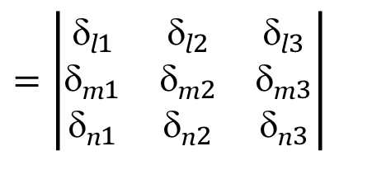
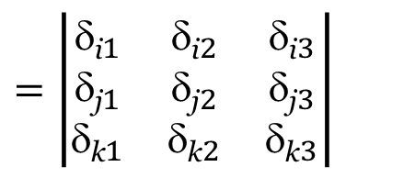
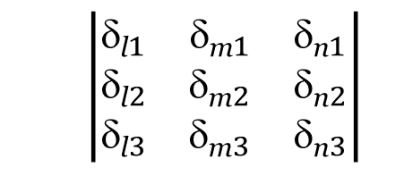
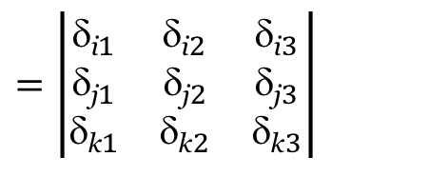
$$=\left|\begin{matrix}{\text{}\text{i}}_{1} & {\text{}\text{i}}_{2} & {\text{}\text{i}}_{3} \\ {\text{}\text{j}}_{1} & {\text{}\text{j}}_{2} & {\text{}\text{j}}_{3} \\ {\text{}\text{k}}_{1} & {\text{}\text{k}}_{2} & {\text{}\text{k}}_{3}\end{matrix}\right|$$
$$=\left|\begin{matrix}{\text{}\text{l}}_{1} & {\text{}\text{l}}_{2} & {\text{}\text{l}}_{3} \\ {\text{}\text{m}}_{1} & {\text{}\text{m}}_{2} & {\text{}\text{m}}_{3} \\ {\text{}\text{n}}_{1} & {\text{}\text{n}}_{2} & {\text{}\text{n}}_{3}\end{matrix}\right|$$
$$\left|\begin{matrix}{\text{}\text{l}}_{1} & {\text{}\text{m}}_{1} & {\text{}\text{n}}_{1} \\ {\text{}\text{l}}_{2} & {\text{}\text{m}}_{2} & {\text{}\text{n}}_{2} \\ {\text{}\text{l}}_{3} & {\text{}\text{m}}_{3} & {\text{}\text{n}}_{3}\end{matrix}\right|$$
ε_{ijk}
ε_{lmn}
Transpose
=
$$=\left|\begin{matrix}{\text{}\text{i}}_{1} & {\text{}\text{i}}_{2} & {\text{}\text{i}}_{3} \\ {\text{}\text{j}}_{1} & {\text{}\text{j}}_{2} & {\text{}\text{j}}_{3} \\ {\text{}\text{k}}_{1} & {\text{}\text{k}}_{2} & {\text{}\text{k}}_{3}\end{matrix}\right|$$
$$\left|\begin{matrix}{\text{}\text{l}}_{1} & {\text{}\text{m}}_{1} & {\text{}\text{n}}_{1} \\ {\text{}\text{l}}_{2} & {\text{}\text{m}}_{2} & {\text{}\text{n}}_{2} \\ {\text{}\text{l}}_{3} & {\text{}\text{m}}_{3} & {\text{}\text{n}}_{3}\end{matrix}\right|$$
ε_{ijk}
ε_{lmn}
×
c¹¹ = δ_{i1}δ_{l1} + δ_{i2}δ_{l2} + δ_{i3}δ_{l3} = δ_{ip}δ_{lp} = δ_{il}
c¹² = δ_{i1}δ_{m1} + δ_{i2}δ_{m2} + δ_{i3}δ_{m3} = δ_{ip}δ_{mp} = δ_{im}
c¹³ = δ_{i1}δ_{n1} + δ_{i2}δ_{n2} + δ_{i3}δ_{n3} = δ_{ip}δ_{np} = δ_{in}
$$=\left|\begin{matrix}{\text{}\text{i}}_{l} & {\text{}\text{i}}_{m} & {\text{}\text{i}}_{n} \\ {\text{}\text{j}}_{l} & {\text{}\text{j}}_{m} & {\text{}\text{j}}_{n} \\ {\text{}\text{k}}_{l} & {\text{}\text{k}}_{m} & {\text{}\text{k}}_{n}\end{matrix}\right|$$
ε_{ijk}
ε_{lmn}
ε_{ijk}
ε_{lmn}
= δ_{il} δ_{jm}${\text{}\text{k}}_{n}$+ δ_{jl} δ_{km}${\text{}\text{i}}_{n}$+ δ_{im} δ_{jn}${\text{}}_{kl}$− ${\text{}}_{kl}$δ_{jm}${\text{}\text{i}}_{n}$ − δ_{jl}δ_{im}${\text{}}_{kn}$ − δ_{km} δ_{jn}δ_{il}

Slide 4







ε_{ijk}
ε_{lmn}
= δ_{il} δ_{jm}${\text{}\text{k}}_{n}$+ δ_{jl} δ_{km}${\text{}\text{i}}_{n}$+ δ_{im} δ_{jn}${\text{}}_{kl}$− ${\text{}}_{kl}$δ_{jm}${\text{}\text{i}}_{n}$ − δ_{jl}δ_{im}${\text{}}_{kn}$ − δ_{km} δ_{jn}δ_{il}
ε_{ijk}
Convolution: l = i, m = j, n = k:
ε_{ijk}
= 3(1×1) + 3(−1)×(− 1) = 3 + 3 = 6
Convolution: m = j, n = k:
ε_{ijk}
ε_{ljk}
= δ_{il} δ_{jj}${\text{}\text{k}}_{k}$+ δ_{jl} δ_{kj}${\text{}\text{i}}_{k}$+ δ_{ij} δ_{jk}${\text{}}_{kl}$− ${\text{}}_{kl}$δ_{jj}${\text{}\text{i}}_{k}$ − δ_{jl}δ_{ij}${\text{}}_{kk}$ − δ_{kj} δ_{jk} δ_{il} =
9$\text{}\text{il}$
δ_{jl} ${\text{}}_{ij}=\text{δ}\text{il}$
δ_{ij} ${\text{}}_{jl}=\text{δ}\text{i}\text{l}$
δ_{𝑗𝑗} δ_{il} $=\text{3}\text{δ}\text{i}\text{l}$
3$\text{}\text{il}$
$${\text{}}_{jj}\text{δ}\text{il}=\text{3}\text{δ}\text{i}\text{l}$$
= 9δ_{il} + ${\text{}}_{li}$+ δ_{il} − ${\text{3}\text{δ}\text{i}}_{l}$ − 3 δ_{il} − 3 δ_{il} = 2δ_{il}
Convolution: n = k:
ε_{ijk}
ε_{lmk}
= δ_{il} δ_{jm}${\text{}\text{k}}_{k}$+ δ_{jl} δ_{km}${\text{}\text{i}}_{k}$+ δ_{im} δ_{jk}${\text{}}_{kl}$− ${\text{}}_{kl}$δ_{jm}${\text{}\text{i}}_{k}$ − δ_{jl}δ_{im}${\text{}}_{kk}$ − δ_{km} δ_{jk} δ_{il} =
3δ_{jm} $\text{}\text{i}\text{l}$
δ_{jl} ${\text{}}_{im}$
δ_{im} ${\text{}}_{jl}$
δ_{jm} $\text{}\text{i}\text{l}$
3δ_{jl} ${\text{}}_{im}$
δ_{jm} $\text{}\text{i}\text{l}$
= 3$\text{}\text{i}\text{l}$δ_{jm} +δ_{jl} ${\text{}}_{im}$+ δ_{im}${\text{}}_{jl}$ − ${\text{}\text{i}}_{l}$δ_{jm}− 3δ_{jl}δ_{im} − ${\text{}\text{i}}_{l}$ δ_{jm} =
= $\text{}\text{i}\text{l}$δ_{jm}
− δ_{im}${\text{}}_{jl}$
ε_{ijk}ε_{ijk} = 6
ε_{ijk}ε_{ijn} = ε_{kij}ε_{nij} = 2δ_{kn}
ε_{ijk}ε_{lmk} ≡ ε_{kij}ε_{klm} = δ_{il} δ_{jm} – δ_{im}δ_{jl}
$$\begin{matrix}i j k \\ \\ l m k\end{matrix}$$
$$\begin{matrix}i j k \\ \\ l m k\end{matrix}$$

Slide 5
→
→
→
→
→
→
→
→
→
→
→
→
→
→
→
→
→
→
→
→
→
→
→
→
→
→
→
→
→
T₁ = T_{i1} e_{i} = T₁₁e₁ + T₂₁e₂ + T₃₁e₃,
T₂ = T_{i2} e_{i} = T₁₂e₁ + T₂₂e₂ + T₃₂e₃,
T₃ = T_{i3} e_{i} = T₁₃e₁ + T₂₃e₂ + T₃₃e₃,
→
→
→
→
→
T₁ is collinear with e₁, if and only if T₂₁ = T₃₁ = 0
→
→
→
→
→
→
T₂ is collinear with e₂, if and only if T₁₂ = T₃₂ = 0
→
→
→
→
→
→
T₃ is collinear with e₃, if and only if T₁₃ = T₂₃ = 0

Slide 6
→
T₃
→
T₃
e₃
→
e₃
→
→
→
T₂
T₂
e₂
→
→
T₁
e₂
→
→
T₁
e₁
e₁
→
→
→
→
→
→
→
→
→

Slide 7
Definition
The direction which is given by a unit vector , and has the property that the vector projection of the tensor T on such direction is collinear with the vector
is called the principal direction (principal axis) of the tensor T, and the value λ equal to the length of this vector projection is called the principal value (eigenvalue) of the tensor T.
→
→
T_{ij} μ_{j} e_{i} = λ e_{i} , → T_{1j} μ_{j} = λμ₁ , T_{2j} μ_{j} = λμ₂ , T_{3j} μ_{j} = λμ₃
T_{ij} μ_{j} = λμ_{i} , T_{ij} μ_{j} = λδ_{ij} μ_{j}.
→
→
(T_{ij} μ_{j} – λδ_{ij} μ_{j} ) = 0 (i =1, 2, 3),

Slide 8
(T_{ij} μ_{j} – λδ_{ij} μ_{j} ) = 0 (i =1, 2, 3),
(T₁₁ – λ) μ₁ + T₁₂ μ₂ + T₁₃ μ₃ = 0,
T₂₁ μ₁ + (T₂₂ – λ) μ₂ + T₂₃ μ₃ = 0,
T₃₁ μ₁ + T₃₂ μ₂ + (T₃₃ – λ) μ₃ = 0,
μ_{i} μ _{i} = 1.
det(T_{ij} – λδ_{ij}) = 0,

Slide 9
λ³ – I₍₁₎λ² + I₍₂₎λ − I₍₃₎ = 0,
I₍₁₎ = T_{ii} ,
I₍₂₎ = M_{ii} = (T_{ii} T_{jj} – T_{ij} T_{ji}),
I₍₃₎ = det(T_{ij}),
INVARIANTS
→
→
→

Slide 10
Symmetric tensor
a) two distinct real roots (λ⁽²⁾ and λ⁽³⁾) each associated with its own direction given by the unit vector or ;
b) two coinciding roots (λ⁽²⁾ = λ⁽³⁾). This is possible only if
Then
All orthogonal to directions are principal

Slide 11
T ′_{ii} = α_{ik} α_{im} T_{km} = δ _{km} T_{km} = T_{kk} = T_{ii} - invariant
I₍₂₎ = M_{ii} = (T_{ii} T_{jj} – T_{ij} T_{ji}),
T ′_{ij} T ′_{ji} = α_{ik} α_{jm} T_{km} α_{jp} α_{iq} T_{pq} =
α_{ik} α_{jm} T_{km} α_{jp} α_{iq} T_{pq} =
= α_{ik} α_{iq} α_{jm}α_{jp} T_{km} T_{pq}
= δ_{kq}δ_{mp} T_{km} T_{pq} =
δ_{kq} δ_{mp}
= T_{qm} T_{mq} - invariant

Slide 12
T′ = ATA^{–1}
Det T′ = det(ATA^{–1}) = det A det T det A^{–1} = det T
(det A det A^{–1} = det (AA^{–1}) = det E = 1).
Theorem
The determinant of the tensor matrix T remains the same after passing to another orthonormal coordinate system (though the matrix itself does change after it):
det T′ = det T

Slide 13
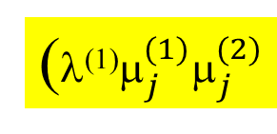


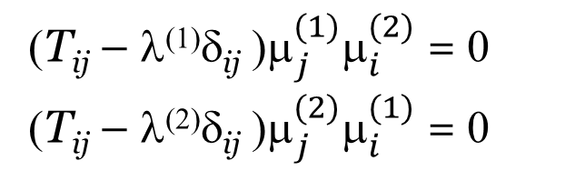
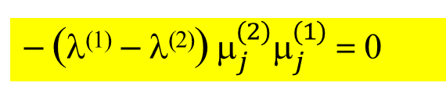
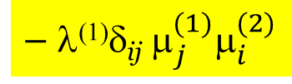
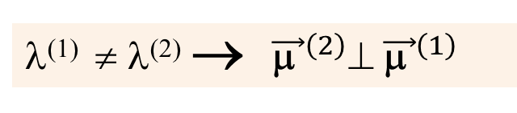
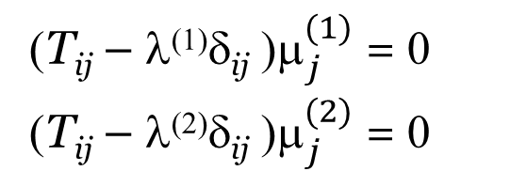



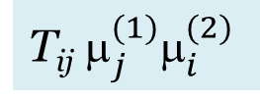
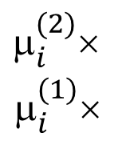
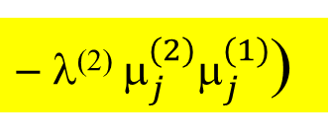
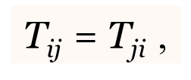
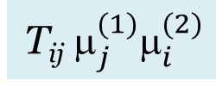


Theorem (on orthogonality). Non-equal principal values of a symmetric second-rank tensor correspond to mutually orthogonal principal axes:
T_{ij} = $\text{T}\text{j}\text{i}$,
λ⁽¹⁾ ≠ λ⁽²⁾ → ${\vec{\text{μ} }}^{\left(2\right)}⊥ {\vec{\text{μ} }}^{\left(1\right) }$
$_{i}^{(2)}$×
$_{i}^{(1)}$×
(T_{ij} – λ⁽¹⁾δ_{ij} ${\text{)}μ}_{j}^{(1)}$ = 0
(T_{ij} – λ⁽²⁾δ_{ij} ${\text{)}μ}_{j}^{(2)}$ = 0
(T_{ij} – λ⁽¹⁾δ_{ij} ${\text{)}μ}_{j}^{(1)}μ_{i}^{(2)}$ = 0
(T_{ij} – λ⁽²⁾δ_{ij} ${\text{)}μ}_{j}^{(2)}μ_{i}^{(1)}$ = 0
(i =1, 2, 3)
−
T_{ij} $_{j}^{(1)}_{i}^{(2)}$
– λ⁽¹⁾δ_{ij} $_{j}^{(1)}_{i}^{(2)}$
$$\text{–} \text{T}\text{ij}{ μ}_{j}^{(2)}μ_{i}^{(1)}$$
$$\text{+} \text{λ}\text{(2)}\text{δ}\text{ij} μ_{j}^{(2)}μ_{i}^{(1)}$$
= 0
T_{ij} $_{j}^{(1)}_{i}^{(2)}$
$$\text{–} \text{T}\text{ij} μ_{i}^{(1)}{ μ}_{j}^{(2)}$$
−
(λ⁽¹⁾$_{j}^{(1)}_{j}^{(2)}$
$\text{} \text{λ}\text{(2)} μ_{j}^{(2)}μ_{j}^{(1)}$)
= 0
T_{ij} $_{j}^{(1)}_{i}^{(2)}$– $\text{T}\text{j}iμ_{i}^{\left(1\right)}μ_{j}^{(2)}$
= T_{kl} $_{l}^{(1)}_{k}^{(2)}$–$\text{T}kl{ μ}_{l}^{\left(1\right)}$ $_{l}^{(2)}=0$
– (λ⁽¹⁾ – λ⁽²⁾)$_{j}^{(2)}_{j}^{(1)}$ = 0
if λ⁽¹⁾ ≠ λ⁽²⁾ , $\text{then}{ μ}_{j}^{(2)}μ_{j}^{(1)} \text{= }\text{0}$
$${\vec{\text{μ}}}^{\left(2\right)}⊥ {\vec{\text{μ}}}^{\left(1\right) }$$
→

Slide 14


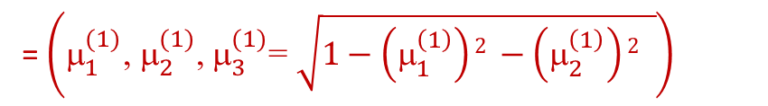

Theorem. If a symmetric second-rank tensor has three non-equal principal values λ⁽¹⁾, λ⁽²⁾, λ⁽³⁾, then these values correspond to the three mutually orthogonal principal axes , ,
→
→
→
such that
→
= λ^{(i)}
(No summing up be upper indexes)
→
and this triplet of vectors is unique (up to the sign).
P_{μ1}
= $\left({\text{}}_{1}^{(1)}\text{, }{\text{}}_{2}^{(1)}\text{, }{\text{}}_{3}^{(1)}\text{= }\sqrt{1−\left(_{1}^{\left(1\right)}\right)2 −\left(_{2}^{\left(1\right)}\right)2 }\right)$
$${\vec{\text{μ}}}^{(1)}$$
$${\vec{\text{μ}}}^{(2)}$$
$${\vec{\text{μ}}}^{(3)}$$
Theorem. The matrix of the tensor T will be diagonal in a basis composed of the principal axes ( = = ; = = ; = =
→
→
→
→
→
→
→
→
→
→
and vice versa, if the matrix of the tensor is diagonal in a particular basis, then the basis vectors will coincide with the principal axes

Slide 15
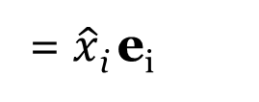
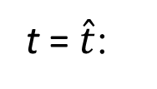
Lagrangian Description of Motion of Continuous Medium
x₃
Inertial observer’s (resting and Cartesian)
→
w
→
w
→
e₃
→
e₃
→
→
x₂
e₂
x₂
e₂
→
→
e₁
e₁
→
→
t = 0:
r = r° = x_{i} e_{i}
t = $\hat{t}$:
r =
= $\hat{x}$_{i} e_{i}
→
→
°
→
→
→
x₁
x₁
The Lagrangian description ↔ all continuum variables are functions of Lagrangian coordinates:
r = r(ξ₁, ξ₂, ξ₃, t), v = v(ξ₁, ξ₂, ξ₃, t), … , T = T(ξ₁, ξ₂, ξ₃, t).
→
→
→
→

Slide 16
Eulerian Description of Motion of Continuous Medium
All continuum variables are functions of Eulerian coordinates:
→
→
v = v(x₁, x₂, x₃, t), … , T = T(x₁, x₂, x₃, t)

Slide 17




COMOVING COORDINATE SYSTEM (curvelinear)
x₃
ξ₂
r = x₁e₁ + x₂e₂ + x₃e₃
→
→
→
→
→
→
dr°
→
→
ξ₃
→
→
e₁ =
→
ξ₃
→
ξ₁
ξ₂
d$\hat{r}$
→
r
→
w
→
→
e₂ =
→
→
ξ₁
→
e₃
→
e₃ =
→
→
Comoving
(curvilinear)
→
$\hat{r}$ = $\hat{r}$(ξ₁, ξ₂, ξ₃, t)
→
→
t = $\hat{t}$:
Inertial observer’s (resting and Cartesian)
→
e₂
x₂
→
→
e₁
→
→
→
x₁
Comoving
(curvilinear)
→
→
$r^{∘}$= $r^{∘}$(ξ₁, ξ₂, ξ₃, t)
→
→
t = 0:
₃
∂ξ₃
₁
→
→
→
→
→
→
∂ξ₃

Slide 18
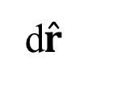

dr°
→
d$\hat{r}$
→
Small
Fiber
t = 0
t = $\hat{t}$
→
d
→
→
d
→
- scalar
- scalar

Slide 19


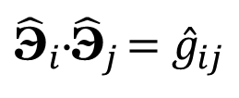









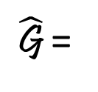

$${\hat{\text{Э}}}_{j}$$
- scalar
- scalar
Theorem
The dot products of basis vectors and
Mathematical object - 9 numbers
Contraction with two vectors and for
Contraction with two vectors and for
By the theorem of the Scalar Division mathematical objects and
with basic dyads and
constitute a second-rank tensors
${\text{Э}}_{i}^{o}$⋅${\text{Э}}_{j}^{o}$ = $g_{ij}^{∘}$
${\hat{\text{Э}}}_{i}$⋅${\hat{\text{Э}}}_{j}$ ${=\hat{g}}_{ij}$
dr°
dr°
$$g_{ij}^{∘}$$
→
→
d$\hat{r}$
d$\hat{r}$
$${\hat{g}}_{ij}$$
$$g_{ij}^{∘}$$
$${\hat{g}}_{ij}$$
$${\text{Э}}_{i}^{o}{\text{Э}}_{j}^{o}$$
$${\hat{\text{Э}}}_{i}{\hat{\text{Э}}}_{j}$$
G°=
$${g_{ij}^{∘}\text{Э}}_{i}^{o}{\text{Э}}_{j}^{o}$$
$\hat{\text{G}}$ =
${\hat{g}}_{ij}{\hat{\text{Э}}}_{i}{\hat{\text{Э}}}_{j}$

Slide 20

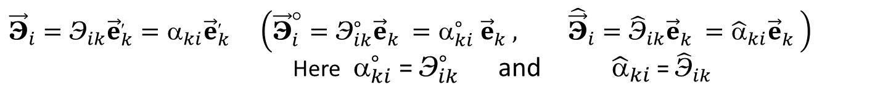
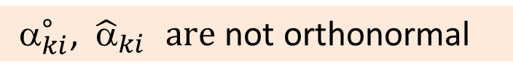

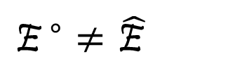


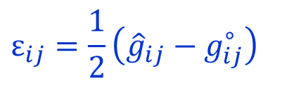
Cartesian and curvilinear coordinates (fibers)
$${\vec{\text{Э}}}_{i}={\text{Э}}_{ik}{\vec{e}}_{k}^{′}={\text{α}}_{ki}{\vec{e}}_{k}^{′ } \left({\vec{\text{Э}}}_{i}^{°}={\text{Э}}_{ik}^{∘}{\vec{e}}_{k}^{}={α_{ki}^{∘}}_{ }{\vec{e}}_{k}^{}, {\hat{\vec{\text{Э}}}}_{i}={\hat{\text{Э}}}_{ik}{\vec{e}}_{k}^{}={\hat{α}}_{ki}{\vec{e}}_{k}^{}\right)$$
Here ${ }_{ki}^{∘}$ = ${\text{Э}}_{ik}^{∘}$ and ${\hat{α}}_{ki}$ = ${\hat{\text{Э}}}_{ik}$
Metric tensors
not orthogonal
in general case
$${\text{G}}^{°}$$
$${=g}_{ij}^{∘}\overset{∘}{\text{Э}}​_{i}{\overset{∘}{\text{Э}}}_{j }=g_{ij}^{∘}{{ α}_{ki}^{∘}{ α}_{kj}^{∘} {\vec{e}}_{k}^{}{\vec{e}}_{l}^{}=g}_{kl}^{°(e)}{\vec{e}}_{k}^{}{\vec{e}}_{l}^{} \left(g_{kl}^{°(e′)}={ α}_{ki}^{∘}α_{ki}^{∘}g_{ij}^{∘}={\text{Э}}_{ik}{\text{Э}}_{jk}g_{ij}\right)$$
$$\hat{\text{G}}$$
$=$ ${\hat{g}}_{ij}$ ${\hat{\text{Э}}}_{i}{\hat{\text{Э}}}_{j}$ $=$ ${\hat{g}}_{ij}$ ${\hat{α}}_{ki}$ ${\hat{α}}_{kj}$ ${\vec{e}}_{k}^{}{\vec{e}}_{l}^{}$ = ${\hat{g}}_{kl}^{(e′)}$ ${\vec{e}}_{k}^{}{\vec{e}}_{l}^{}$ $\left({\hat{g}}_{kl}^{(e′)}={\hat{α}}_{ki} {\hat{α}}_{kj}{\hat{g}}_{ij}={\text{Э}}_{ik}{\text{Э}}_{jk}g_{ij}\right)$
${ }_{ki}^{∘}$, ${\hat{α}}_{ki } are$ not orthonormal
Lagrangian and Eulerian strain tensors
$$ε_{ij}=\frac{1}{2}\left({\hat{g}}_{ij}−g_{ij}^{∘}\right)$$
$${\text{E} }^{∘}=ε_{ij}\overset{∘}{\text{Э}}​_{i}{\overset{∘}{\text{Э}}}_{j}=ε_{ij}{\text{Э}}_{ik}^{∘}{\text{Э}}_{jl}^{∘}e_{k}e_{l}=ε_{kl}^{∘(e)}e_{k}e_{l}$$
- Lagrangian Strain Tensor
$$\hat{\text{E} }=ε_{ij}{\hat{\text{Э}}}_{i}{\hat{\text{Э}}}_{j}=ε_{ij}{\hat{\text{Э}}}_{ik}{\hat{\text{Э}}}_{jl}e_{k}e_{l}={\hat{ε}}_{ij}^{(e)}e_{k}e_{l}$$
- Eulerian Strain Tensor
$${\text{E} }^{∘}≠\hat{\text{E} }$$

Slide 21



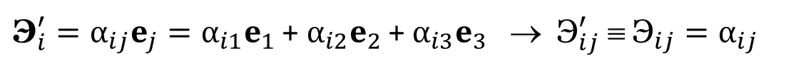




Orthogonal Transformations of Coordinates
x₃
$$x_{3}^{′}$$
e₃
→
$$e_{3}^{′}$$
$$x_{2}^{′}$$
→
$$e_{2}^{′}$$
→
e₂
→
e₁
x₂
→
$$e_{1}^{′}$$
→
$$x_{1}^{′}$$
x₁
→
→
→
→
→
→
→
→
→
→
→
→
→
→
→
→
→
→
→
Rule of primed indices
The first index (i) in α_{ij} corresponds to the primed basis vector
→
→
→
→
$$x_{i}^{′}=α_{ij}x$$
→
${\text{Э}}_{i}^{′}=α_{ij}e_{j}=α_{i1}e_{1}$ + $α_{i2}e_{2}$ + $α_{i3}e_{3}$ → ${\text{Э}}_{ij}^{′} ≡ {\text{Э}}_{ij}=α_{ij}$
→
→
→
→

Slide 22

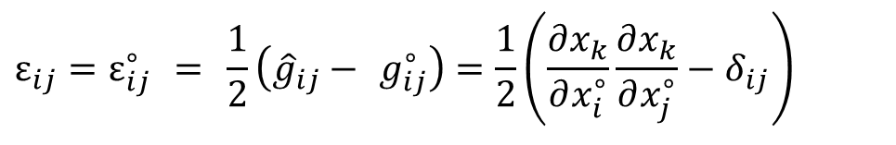

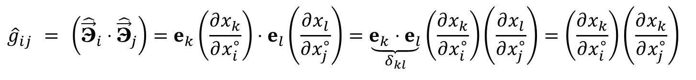
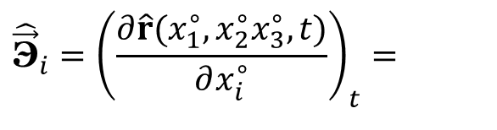
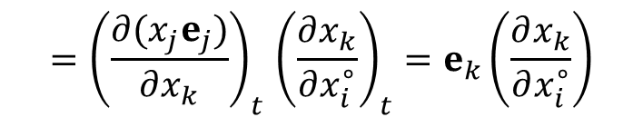
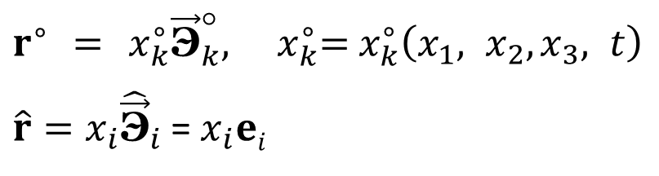
x₃
$$r^{∘}​ = x_{k}^{∘}{\vec{\text{Э}}}_{k}^{°}, ​x_{k}^{∘}​\text{= }x_{k}^{∘}​\left(x_{1}, x_{2},x_{3}, t\right)$$ $\hat{r}=x_{i}{\hat{\vec{\text{Э}}}}_{i}$ = $x_{i}ei$
→
→
→
→
→
→
→
→
→
$${\vec{\text{Э}}}_{i}^{°}=e_{i},$$
→
→
→
w
→
→
$${\hat{\vec{\text{Э}}}}_{i}={\left(\frac{∂\hat{r}(x_{1}^{∘},x_{2}^{∘}x_{3}^{∘}, t)}{∂x_{i}^{∘}}\right)}_{t}=$$
e₃
→
→
→
→
$${=\left(\frac{∂(x_{j}e_{j})}{∂x_{k}}\right)}_{t}{\left(\frac{∂x_{k}}{∂x_{i}^{∘}}\right)}_{t}=e_{k}\left(\frac{∂x_{k}}{∂x_{i}^{∘}}\right)$$
e₂
x₂
→
→
→
e₁
→
x₁
$$g_{ij}^{∘}=(e_{i}⋅e_{j})=δ_{ij}$$
→
→
$${\hat{g}}_{ij} = \left({\hat{\vec{\text{Э}}}}_{i}⋅{\hat{\vec{\text{Э}}}}_{j}\right)=e_{k}\left(\frac{∂x_{k}}{∂x_{i}^{∘}}\right)⋅e_{l}\left(\frac{∂x_{l}}{∂x_{j}^{∘}}\right)=\underset{δ_{kl}}{\underbrace{e_{k}⋅e_{l}}}\left(\frac{∂x_{k}}{∂x_{i}^{∘}}\right)\left(\frac{∂x_{l}}{∂x_{j}^{∘}}\right)=\left(\frac{∂x_{k}}{∂x_{i}^{∘}}\right)\left(\frac{∂x_{k}}{∂x_{j}^{∘}}\right)$$
→
→
→
→
Components of Green–Lagrange second-rank symmetric strain tensor
$$ε_{ij}=ε_{ij}^{∘} = \frac{1}{2}\left({\hat{g}}_{ij}− g_{ij}^{∘}\right)=\frac{1}{2}\left(\frac{∂x_{k}}{∂x_{i}^{∘}}\frac{∂x_{k}}{∂x_{j}^{∘}}−δ_{ij}\right)$$

Slide 23

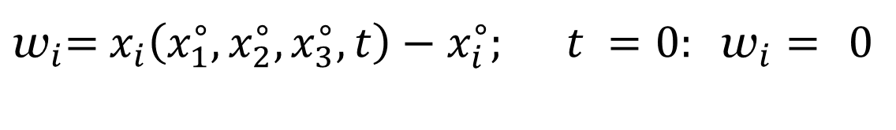
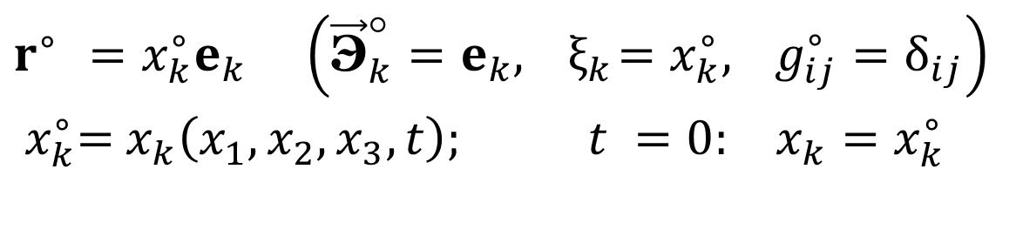

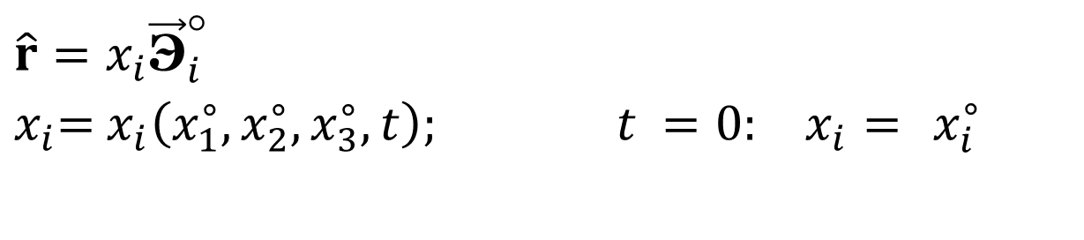

Strain Tensor
$$r^{∘} ​=x_{k}^{∘}e_{k} \left({\vec{\text{Э}}}_{k}^{°}=e_{k}, { ξ}_{k}=x_{k}^{∘}, g_{ij}^{∘}=δ_{ij}\right)​ \\ { x}_{k}^{∘}​\text{= }x_{k}\left(x_{1},x_{2},x_{3},t\right); t =0: x_{k}=x_{k}^{∘}$$
→
→
→
$$\left(k=1, 2, 3\right)$$
$$\hat{r}=x_{i}​{\vec{\text{Э}}}_{i}^{°} \\ x_{i}​\text{= }x_{i}\left(x_{1}^{∘},x_{2}^{∘},x_{3}^{∘},t\right); t =0: x_{i}​= x_{i}^{∘}$$
→
$$\left(i=1, 2, 3\right)$$
$${\text{w}}_{i}​\text{= }x_{i}\left(x_{1}^{∘},x_{2}^{∘},x_{3}^{∘},t\right)−x_{i}^{∘}; t =0: {\text{w}}_{i}​= 0$$
$$\left(i=1, 2, 3\right)$$
w

Slide 24
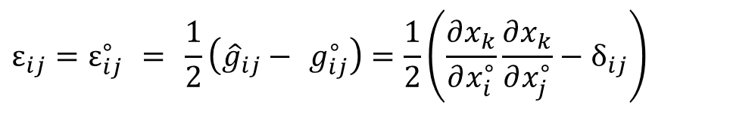

Components of Green–Lagrange second-rank symmetric strain tensor
$$ε_{ij}=ε_{ij}^{∘} = \frac{1}{2}\left({\hat{g}}_{ij}− g_{ij}^{∘}\right)=\frac{1}{2}\left(\frac{∂x_{k}}{∂x_{i}^{∘}}\frac{∂x_{k}}{∂x_{j}^{∘}}−δ_{ij}\right)$$
$${\text{w}}_{i}​ \text{= }x_{i}\left(x_{1}^{∘},x_{2}^{∘},x_{3}^{∘}, t\right)−x_{i}^{∘}$$

Slide 25


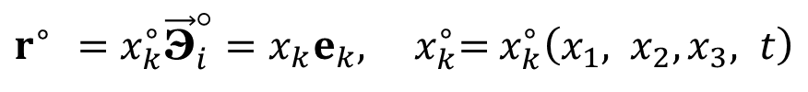
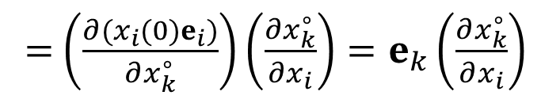
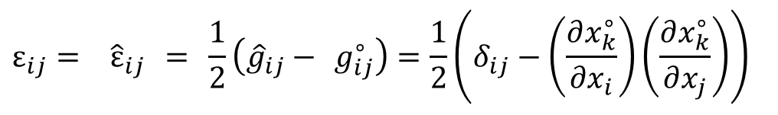

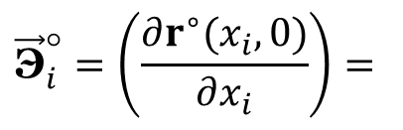

x₃
$$r^{∘}​ =x_{k}^{∘}{\vec{\text{Э}}}_{i}^{°}=x_{k}e_{k}, ​x_{k}^{∘}​\text{= }x_{k}^{∘}​\left(x_{1}, x_{2},x_{3}, t\right)$$
→
→
→
$\hat{r}=x_{k}{\hat{\vec{\text{Э}}}}_{k}$, ${\hat{\vec{\text{Э}}}}_{k}$ = e_{k}
→
→
→
$${\vec{\text{Э}}}_{i}^{°}=\left(\frac{∂r^{∘}(x_{i},0)}{∂x_{i}}\right)=$$
→
$$x_{3}$$
w
→
→
e₃
= $\left(\frac{∂(x_{i}(0)e_{i})}{∂x_{k}^{∘}}\right)\left(\frac{∂x_{k}^{∘}}{∂x_{i}}\right)=e_{k}\left(\frac{∂x_{k}^{∘}}{∂x_{i}}\right)$
→
→
→
→
$$​x_{2}$$
→
e₂
x₂
→
→
→
$$x_{1}$$
e₁
→
x₁
→
→
→
→
→
→
→
→
Components of Eulerian Almansi second-rank symmetric strain tensor
$$ε_{ij}= {\hat{ε}}_{ij} = \frac{1}{2}\left({\hat{g}}_{ij}− g_{ij}^{∘}\right)=\frac{1}{2}\left(δ_{ij}−\left(\frac{∂x_{k}^{∘}}{∂​x_{i}}\right)\left(\frac{∂x_{k}^{∘}}{∂x_{j}}\right)\right)$$

Slide 26
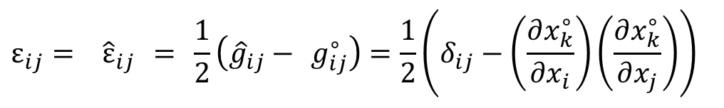
Components of Eulerian Almansi second-rank symmetric strain tensor
$$ε_{ij}= {\hat{ε}}_{ij} = \frac{1}{2}\left({\hat{g}}_{ij}− g_{ij}^{∘}\right)=\frac{1}{2}\left(δ_{ij}−\left(\frac{∂x_{k}^{∘}}{∂​x_{i}}\right)\left(\frac{∂x_{k}^{∘}}{∂x_{j}}\right)\right)$$
Components of Eulerian Almansi strain tensor
Components of Green–Lagrange strain tensor

Slide 27
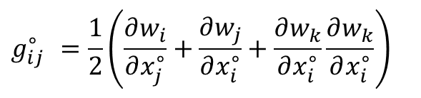

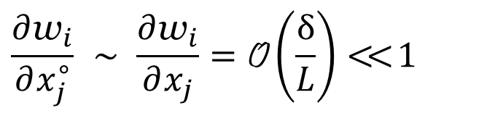

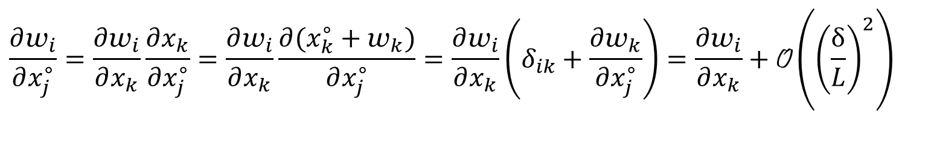
$$g_{ij}^{∘} =\frac{1}{2}\left(\frac{∂w_{i}}{∂x_{j}^{∘}}+\frac{∂w_{j}}{∂x_{i}^{∘}}+\frac{∂w_{k}}{∂x_{i}^{∘}}\frac{∂w_{k}}{∂x_{i}^{∘}}\right)$$
→
→
→
→
→
If relative displacement is small:
δw ∼ δ << L
$$\frac{∂{\text{w}}_{i}}{∂x_{j}^{∘}}​ \sim \frac{∂{\text{w}}_{i}}{∂x_{j}}=\text{O}\left(\frac{δ}{L}\right)<<1$$
$$\frac{∂{\text{w}}_{i}}{∂x_{j}^{∘}}=\frac{∂{\text{w}}_{i}}{∂x_{k}}\frac{∂x_{k}}{∂x_{j}^{∘}}=\frac{∂{\text{w}}_{i}}{∂x_{k}}\frac{∂(x_{k}^{∘}+{\text{w}}_{k})}{∂x_{j}^{∘}}=\frac{∂{\text{w}}_{i}}{∂x_{k}}\left(δ_{ik}+\frac{∂{\text{w}}_{k}}{∂x_{j}^{∘}}\right)=\frac{∂{\text{w}}_{i}}{∂x_{k}}+\text{O}\left({\left(\frac{δ}{L}\right)}^{2}\right)$$

Slide 29
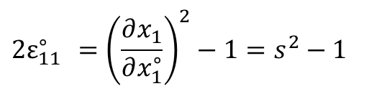
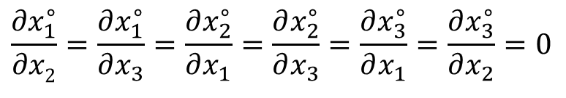
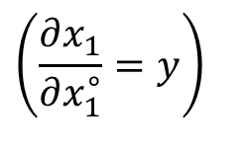




One-dimensional motion
$$\frac{∂x_{1}}{∂x_{2}^{∘}}=\frac{∂x_{1}}{∂x_{3}^{∘}}=\frac{∂x_{2}}{∂x_{1}^{∘}}=\frac{∂x_{2}}{∂x_{3}^{∘}}=\frac{∂x_{3}}{∂x_{1}^{∘}}=\frac{∂x_{3}}{∂x_{2}^{∘}}=0$$
$$\left(\frac{∂x_{1}}{∂x_{1}^{∘}}=y\right)$$
$$\frac{∂​x_{1}^{∘}}{∂x2}=\frac{∂x_{1}^{∘}}{∂x_{3}}=\frac{∂x_{2}^{∘}}{∂x_{1}}=\frac{∂x_{2}^{∘}}{∂x_{3}}=\frac{∂x_{3}^{∘}}{∂x_{1}}=\frac{∂x_{3}^{∘}}{∂x_{2}}=0$$
$$\left(\frac{∂x_{1}^{∘}}{∂x_{1}}=\frac{1}{y}\right)$$
$${2ε}_{11}^{∘} =\frac{∂x_{k}}{∂x_{1}^{∘}}\frac{∂x_{k}}{∂​x_{1}^{∘}}−δ_{ij}= \frac{∂x_{1}}{∂x_{1}^{∘}}\frac{∂x_{1}}{∂x_{1}^{∘}}+\frac{∂x_{2}}{∂x_{1}^{∘}}\frac{∂x_{2}}{∂x_{1}^{∘}}+\frac{∂x_{1}}{∂x_{1}^{∘}}\frac{∂x_{1}}{∂x_{1}^{∘}}−1={\left(\frac{∂x_{1}}{∂x_{1}^{∘}}\right)}^{2}−1=s^{2}−1$$
$${2ε}_{11}^{∘} ={\left(\frac{∂x_{1}}{∂x_{1}^{∘}}\right)}^{2}−1=s^{2}−1$$
$$2{\hat{ε}}_{11} = δ_{11}−\left(\frac{∂x_{k}^{∘}}{∂x_{1}}\right)\left(\frac{∂x_{k}^{∘}}{∂x_{1}}\right)=1−\frac{1}{s^{2}}=\frac{s^{2}−1}{s^{2}}$$
Lagrangian Strain tensor
Eulerian Strain tensor

Slide 30









Lagrangian coordinates
Eulerian coordinates (current position)
v₁
v
А
v₁
v
A
D′
D
С
D
С
С′
D∗
C∗
D′′
С′′
v₀
t = 0
Overlap
В
В
В′
В∗
0
В′′
А
F
A
F
0
l₀
l∗
х₁
х₁(
, t ) =
+ v₁( )⋅t )
(0 ≤
≤ l₀),
x₂ =
x₃ =
s $= \frac{∂{\text{x}}_{1}}{\text{∂}{\text{x}}_{1}^{∘}}=s=1+\frac{∂{\text{v}}_{1}}{∂{\text{x}}_{1}^{∘}}⋅t=1−\frac{{\text{v}\text{0}}_{∗}}{\text{l}\text{0}}⋅ t ,$
$\frac{{\text{l}\text{0}∗}_{∗}}{{\text{v}\text{0}}_{∗}∗}$ :
$$\frac{∂x_{1}}{∂x_{1}^{∘}}=s=1−1=0$$
t₀ =
$${2ε}_{11}^{∘} ={\left(\frac{∂x_{1}}{∂x_{1}^{∘}}\right)}^{2}−1=s^{2}−1=−1$$
$$ε_{11}^{∘} = ε_{11∗}^{∘}=−1/2,$$
$$ε_{11}^{∘} =ε_{11∗}^{∘}>−1/2$$
$$\text{If} ε_{11}^{∘}<0, \max\left|ε_{11}^{∘}\right|<1/2$$
$$2{\hat{ε}}_{11}=δ_{11}−\left(\frac{∂x_{k}^{∘}}{∂x_{1}}\right)\left(\frac{∂x_{k}^{∘}}{∂x_{1}}\right)=1−\frac{1}{s^{2}}= − $$

Slide 31
Compatibility conditions for strain components.
Strain tensor ε_{ij} has six independent components
ε₁₁, ε₂₂, ε₃₃, ε₁₂ = ε₂₁, ε₁₃ = ε₃₁, ε₂₃ = ε₃₂,
As functions of or they are determined by 3 functions
Since the six distributions ε_{ij}(x₁, x₂, x₃, t) are determined by three functions w_{k}(x₁, x₂, x₃, t), they cannot be arbitrary and must satisfy strain compatibility conditions.
Small relative displacement
δw ∼ δ << L

Slide 32

Nomenclature for the derivative
${\text{w}}_{i,jkl}≡$ $\frac{∂{\text{w}}_{i}}{∂x_{j}{∂x}_{k}{∂x}_{l}}, {\text{ε}}_{ij,kl}$ $$ $\frac{∂ε_{ij}}{{∂x}_{k}{∂x}_{l}}$
Permutation of indices after the comma

Slide 33

Compatibility conditions for strain components.
Strain tensor ε_{ij} has six independent components
ε₁₁, ε₂₂, ε₃₃, ε₁₂ = ε₂₁, ε₁₃ = ε₃₁, ε₂₃ = ε₃₂,
As functions of or they are determined by 3 functions
Since the six distributions ε_{ij}(x₁, x₂, x₃, t) are determined by three functions w_{k}(x₁, x₂, x₃, t), they cannot be arbitrary and must satisfy strain compatibility conditions.
Small relative displacement
δw ∼ δ << L
Nomenclature for the derivative
${\text{w}}_{i,jkl}≡$ $\frac{∂{\text{w}}_{i}}{∂x_{j}{∂x}_{k}{∂x}_{l}}, {\text{ε}}_{ij,kl}$ $$ $\frac{∂ε_{ij}}{{∂x}_{k}{∂x}_{l}}$
Permutation of indices after the comma

Slide 34
For small relative displacement: δw ∼ δ << L
Permutation of indices after the comma
Saint-Venant's compatibility equations
(necessary condition of compatibility)

Slide 35


x₃
$$ε_{ij}=ε_{ij}^{∘}=\frac{1}{2}\left({\hat{g}}_{ij}−g_{ij}^{∘}\right)=\frac{1}{2}\left(\frac{∂x_{k}}{∂x_{i}^{∘}}\frac{∂x_{k}}{∂x_{j}^{∘}}−δ_{ij}\right)$$
→
→
→
→
Components of Green–Lagrange second-rank symmetric strain tensor
→
→
w
→
$$g_{ig}^{∘}=(e_{i}⋅e_{j})=δ_{ij}, {\hat{g}}_{ij} = \left({\hat{Э}}_{i}⋅{\hat{Э}}_{j}\right)$$
→
→
→
→
→
e₃
→
e₂
x₂
→
Small deformations:
e₁
→
x₁
$${\bar{δ}}_{1}=ε_{11}^{∘}+o\left(ε_{11}^{∘}\right), {\hat{ψ}}_{12}=− 2ε_{12}^{∘}+o\left(ε_{11}^{∘}\right)$$
Relative elongation of the 1-st fiber
Change of the angle between the first and the second fibers
$${\bar{δ}}_{2}=ε_{22}^{∘}+\text{o}\left(ε_{22}^{∘}\right), {\bar{δ}}_{2}=ε_{33}^{∘}+\text{o}\left(ε_{33}^{∘}\right), {\hat{ψ}}_{ij}=ε_{ij}^{∘}+\text{o}\left(ε_{ij}^{∘}\right)$$

Slide 36














→
→
3 fibers
dr₁ = dξ₁Э₁, dr₂ = dξ₂Э₂, dr₃ = dξ₃Э₃
→
→
→
→
Let at the initial state (t = 0)
→
→
Green–Lagrange strain tensor
$$\text{d}\text{ξ}\text{i}{=dx}_{i}^{∘}$$
$${dx}_{1}^{∘}$$
$${dx}_{2}^{∘}$$
$${dx}_{3}^{∘}$$
t = 0: = dx₁, = dx₂, = dx₃,
, , .
dx₁
→
$${dx}_{1}^{∘}$$
→
dx₂
dx₃
$${dx}_{2}^{∘}$$
$${dx}_{3}^{∘}$$
→
$${\vec{\text{Э}}}_{i}^{°}=e_{i},$$
→
${\text{Э}}_{i}^{o}{\text{Э}}_{j}^{o}$ = $\frac{π}{2}$
t = 0:
→
→
→
→
$$_{11}^{∘}$$
$$g_{11}^{∘}$$
→
→
→
→
→
→
$\overline{δ}$_{i} – relative elongation of i-th fiber,
ψ_{ij} – change of the angle between i-th and j-th fibers
$$_{12}^{∘}$$
$$g_{12}^{∘}$$
→
→
→
→

Slide 37




$$_{ij}^{∘}$$
If << 1
Small
deformations:
$$ε_{12}^{∘}= \frac{1}{2}\left(1+{\bar{δ}}_{1}\right)\left(1+{\bar{δ}}_{2}\right)\sin{ψ_{12}}, \sin{ψ_{12}}=\frac{2ε_{12}^{∘}}{\left(1+{\bar{δ}}_{1}\right)\left(1+{\bar{δ}}_{2}\right)}$$
Small deformations:
$$ε_{ij}^{∘}<<1 , {\bar{δ}}_{i}<<1, ψ_{ij}<<1$$
$${\bar{δ}}_{1}=ε_{11}^{∘}+o\left(ε_{11}^{∘}\right), {\hat{ψ}}_{12}={2ε}_{12}^{∘}+o\left(ε_{12}^{∘}\right)$$
$${\hat{ψ}}_{ij}={2ε}_{ij}^{∘}+o\left(ε_{12}^{∘}\right)$$
Relative elongation of the 1-st fiber
Change of the angle between the first and the second fibers

Slide 38
x₃
→
→
→
Components of Eulerian Almansi second-rank
symmetric strain tensor
w
→
→
e₃
→
→
→
→
→
→
→
e₂
x₂
→
→
→
→
→
→
→
e₁
→
x₁

Slide 39
Theorem. For any deformation of an infinitesimal material element, there exists a set of Cartesian unit vectors and pointing along the principal axes of strain. In these coordinates, the strain tensor is
represented by a diagonal matrix ε_{ij}; i.e., the fibers aligned with
and (principal fibers) are elongated or shortened while remaining orthogonal
→
→
→
→
→
→
→
→
→
→
→
→
→
→
→
→
→
→

Slide 40
→
→
→
→
→
→
→
→
→
→
→
→
→
→
→
→
→
→
→
→
affine (linear) transformation between components of an arbitrary infinitesimal fiber in the neighborhood of material point M; i.e., the matrix c_{ki} is the same for any fiber in an infinitesimal volume around point M.

Slide 41
1) Planes and lines are preserved (parallel planes and lines remain parallel).
2) Quadratic curves and surfaces are mapped to quadratic curves and surfaces; in particular, an ellipsoid (e.g. sphere) is mapped to an ellipsoid.
3)The stretch ratio is independent of the reference length but depends on orientation; the volume ratio is constant regardless of the shape and volume of the region in question.

Slide 42
An arbitrary displacement of an infinitesimal deformable particle can be viewed as the superposition of the following:
1. Translation (vector w) from position to position ;
Rotation of the principal strain axes about an axis passing through a certain point
3. Contraction or extension along the principal axes of strain
If there is no deformation (no motion of type III), then E = 0. In this case,
C^{(T)}C = E and C^{(T)} = C^{–1}; i.e., C is an orthogonal matrix.
→
→
→
→
→
→

Slide 43
w

Slide 44

Small deformations:
$$ε_{ij}^{∘}<<1 , {\bar{δ}}_{i}<<1, ψ_{ij}<<1$$
$\frac{ρ^{∘}}{ρ}=$ $\left(1+ε_{11}^{∘∗}\right)\left(1+ε_{22}^{∘∗}\right)\left(1+ε_{33}^{∘∗}\right)$ + o($ε_{ii}^{∘∗}$) =
= 1 + $ε_{11}^{∘∗}$ + $ε_{22}^{∘∗} +ε_{33}^{∘∗}$ + o($ε_{ii}^{∘∗}$) =
= 1 + $ε_{11}^{∘}$ + $ε_{22}^{∘} +ε_{33}^{∘}$ + o($ε_{ii}^{∘}$)

Slide 45
Strain Rate Tensor
Definition. The material time rates of change in strain tensor components relative to the current time t,
constitute the components of the second-rank tensor
referred to as strain rate tensor (tensor properties of ε_{ij} are carried over to e_{ij} under material differentiation).

Slide 46
The tensor components Δε_{ij} at can be expressed in a Cartesian comoving coordinate system with
→
→
the strain components Δε_{ij} , which quantify the deformation between
are expressed in terms of components of the displacement
Δw(r, t, Δt) over a time interval Δt as
Δw(r, t, Δt) = v(r, t) Δt + o(Δt).
→
→
→
→
→
→
Then it follows

Slide 47
Strain-rate compatibility equations
The six symmetry tensor components
e_{ij} (i, j =1, 2, 3)
are determined by the spatial distributions of three velocity components
v_{k} (k =1, 2, 3).
Compatibility equations derived from Saint-Venant's compatibility equations
81 equations.
Only three are independent

Slide 48
K′
dr = dx = dx_{i} e_{i}
v^{(K)} dt
→
→
→
→
Velocity distribution v(r, t) about point M by second-order Taylor series expansion
K
→
→
dx′
→
dx
→
→
→
_{M}
M′
→
→
v^{(M)}dt
→

Slide 49

$$ω_{ki}=\frac{1}{2}\left(\frac{∂{\text{v}}_{k}}{∂x_{i}​}−\frac{∂{\text{v} }_{i}}{∂x_{k}​}\right)≡\frac{1}{2}\left(∇_{i}{\text{v} }_{k}−∇_{k}{\text{v}}_{i}\right),$$
$$e_{ki}=\frac{1}{2}\left(\frac{∂{\text{v}}_{k}}{∂x_{i}​}+\frac{∂{\text{v}}_{i}}{∂x_{k}​}\right)≡ \frac{1}{ 2}\left(∇_{i}{\text{v}}_{k}+∇_{k}{\text{v}}_{i}\right)$$
Antisymmetric tensor
Strain rate tensor

Slide 50




Vector product
→
→
→
→
[a×b]_{i} = ε_{ijk}a_{j}b_{k}
→
[a×b] = ε_{ijk}a_{j}b_{k}e_{i} =
→
→
→
→
→
→
→
[∇×v] ≡ curl v ≡ rot v ≡ e_{i} ${ε_{ijk}∇j \text{v}k }_{∇}$
→
→
→
→
∇_{j}v_{k} ≡ ∂v_{k} /x_{j}
For solid body (no deformation)
$$\vec{v}={\vec{v}}^{(M)}+\left[\vec{\text{Ω}}×(\vec{r}−{\vec{r}}^{(M)})\right]$$
${\text{v}}_{k}={\text{v}}_{k}^{(M)}+$ε_{kml}Ω_{m} $\left(x_{l}−x_{l}^{(M)}\right)$
$ω=\frac{1}{2}$ curl v = $\frac{1}{2}e_{i}ε_{ijk}∇j \text{v}k=$
$$\frac{1}{2}ε_{ijk}∇j \left({\text{v}}_{k}^{(M)}+ \text{ε}\text{kml}\text{Ω}\text{m} \left(x_{l}−x_{l}^{(M)}\right)\right)=$$
$= \frac{1}{2}e_{i}ε_{ijk}\text{ε}\text{kml}\text{Ω}\text{m}δjl= \frac{1}{2}e_{i}ε_{ijk}ε_{kmj}\text{Ω}\text{m}= \frac{1}{2}e_{i}ε_{ijk}ε_{mjk}\text{Ω}\text{m}$=
= $\frac{ 1}{2}e_{i}$2$im \text{}\text{m}$= $e_{i}\text{Ω}I$ = Ω
→
→
→
→
→
→
→
→
→
→
→
→
→

Slide 51




ε_{kil} ω_{l}
= ε_{kil} ε_{lmn}∇_{m} v_{n} = ε_{lki} ε_{lmn} ∇_{m} v_{n} =
ε_{ijk}ε_{lmk} ≡ ε_{kij}ε_{klm} = δ_{il} δ_{jm} – δ_{im}δ_{jl}
= (δ_{km} δ_{in} ∇_{m} v_{n} – δ_{kn} δ_{im} ∇_{m} v_{n}) = (∇_{k} v_{i} – ∇_{i} v_{k}) $$ $\frac{1}{2}\left(\frac{\text{∂}\text{v}\text{i}}{\text{∂}\text{x}\text{k}​}−\frac{\text{∂}\text{v}\text{k}}{\text{∂}\text{x}\text{i}​}\right)$=
= ω_{ik} = – ω_{ki},
ε_{ikm} ω_{km} = ε_{ikm}(– ε_{lkm} ω_{l}) = – ε_{ikm} ε_{lkm} ω_{l} = – 2δ_{il} ω_{l} = – 2ω_{i}.
ω_{ik} = – ω_{ki} = ε_{kil} ω_{l}
→
- Coupled (bounded) tensor with angular velocity ω
$$\frac{1}{2}$$
ε_{ikm} ω_{km} = – ω_{i}
- Coupled (bounded) vector with antisymmetric tensor ω_{ik}
ε_{ijk}ε_{ijk} = 6
ε_{ijk}ε_{ijn} = ε_{kij}ε_{nij} = 2δ_{kn}
ε_{ijk}ε_{lmk} ≡ ε_{kij}ε_{klm} = δ_{il} δ_{jm} – δ_{im}δ_{jl}
$$\begin{matrix}i j k \\ \\ l m k\end{matrix}$$
$$\begin{matrix}i j k \\ \\ l m k\end{matrix}$$

Slide 52


ε_{kil} ω_{l}
= ε_{kil} ε_{lmn}∇_{m} v_{n} = ε_{lki} ε_{lmn} ∇_{m} v_{n} =
ε_{ijk}ε_{lmk} ≡ ε_{kij}ε_{klm} = δ_{il} δ_{jm} – δ_{im}δ_{jl}
= (δ_{km} δ_{in} ∇_{m} v_{n} – δ_{kn} δ_{im} ∇_{m} v_{n}) = (∇_{k} v_{i} – ∇_{i} v_{k}) $$ $\frac{1}{2}\left(\frac{\text{∂}\text{v}\text{i}}{\text{∂}\text{x}\text{k}​}−\frac{\text{∂}\text{v}\text{k}}{\text{∂}\text{x}\text{i}​}\right)$=
= ω_{ik} = – ω_{ki},
ε_{ikm} ω_{km} = ε_{ikm}(– ε_{lkm} ω_{l}) = – ε_{ikm} ε_{lkm} ω_{l} = – 2δ_{il} ω_{l} = – 2ω_{i}.
ω_{ik} = – ω_{ki} = ε_{kil} ω_{l}
Coupled (bounded) tensor
with angular velocity ω
→
ε_{ikm} ω_{km} = – ω_{i}
ε_{ijk}ε_{ijk} = 6
ε_{ijk}ε_{ijn} = ε_{kij}ε_{nij} = 2δ_{kn}
ε_{ijk}ε_{lmk} ≡ ε_{kij}ε_{klm} = δ_{il} δ_{jm} – δ_{im}δ_{jl}
$$\begin{matrix}i j k \\ \\ l m k\end{matrix}$$
$$\begin{matrix}i j k \\ \\ l m k\end{matrix}$$

Slide 53

→
→
→
→
→
Theorem (Cauchy–Helmholtz).
Any motion of an infinitesimal deformable particle
can be represented in linear approximation with respect to its size
as a superposition of three motions:
1. Translational motion defined by the vector v^{(M)}.
2. Rotational motion defined by the vector .
3. Deformational motion defined by the strain rate tensor
→
→
$${\dot{\text{E}}}^{(M)}= e_{ij}^{(M)}e_{i}e_{j}$$
→
→

Slide 54
Geometric interpretation of strain rate components
→

Slide 56


$$dr_{1}^{∗}=dr\left(1+e_{11}^{∗}dt\right), dr_{2}^{∗}=dr\left(1+e_{22}^{∗}dt\right), dr_{3}^{∗}=dr\left(1+e_{33}^{∗}dt\right)$$
$$dr_{1}^{∗}$$
V dt
$$dr_{2}^{∗}$$
Invariant

Slide 57
Lagrangian description
r = r(ξ₁, ξ₂, ξ₃, t), … , ρ= ρ(ξ₁, ξ₂, ξ₃, t),
Time derivative
for material particle
(substantial time derivative)
Eulerian description
v = v(x₁, x_{2,}, x₃, t), ρ = ρ(x₁, x_{2,}, x₃, t),
v = v[t, x₁(ξ₁, ξ₂, ξ₃, t), x₂(ξ₁, ξ₂, ξ₃, t), x₃(ξ₁, ξ₂, ξ₃, t)].
ρ = ρ[t , x₁(ξ₁, ξ₂, ξ₃, t), x₂(ξ₁, ξ₂, ξ₃, t), x₃(ξ₁, ξ₂, ξ₃, t)],

Slide 58
Eulerian description
v = v(x₁, x_{2,}, x₃, t), ρ = ρ(x₁, x_{2,}, x₃, t),
v = v[t, x₁(ξ₁, ξ₂, ξ₃, t), x₂(ξ₁, ξ₂, ξ₃, t), x₃(ξ₁, ξ₂, ξ₃, t)].
ρ = ρ[t , x₁(ξ₁, ξ₂, ξ₃, t), x₂(ξ₁, ξ₂, ξ₃, t), x₃(ξ₁, ξ₂, ξ₃, t)],
∂ρ
∂ρ
∂ρ
∂ρ
∂ρ
∂ρ

Slide 59



Time derivative for material particle (substantial time derivative)
for the Eulerian discription
$$\frac{dρ}{dt}≡\frac{∂ρ}{∂t}+v_{1}\frac{∂ρ}{∂x_{1}}+v_{2}\frac{∂ρ}{∂x_{2}}+v_{3}\frac{∂ρ}{∂x_{3}}=$$
≡ $\frac{∂ρ}{∂t}+$
≡ $\frac{∂ρ}{∂t}+$
3
Σ
v_{i} $\frac{∂ρ}{∂x_{i}}$
i = 1
v_{i} $\frac{∂ρ}{∂x_{i}}$

Slide 60

dρ = ρ[t +dt, x + dx] − ρ[t , x]
dx = v dt or dx_{i} = v_{i} dt
→
→
→
→
→
$$\frac{dρ}{dt}≡\frac{ρ\left(t+dt,x+dx\right)−ρ\left(t,x\right)}{dt}=\frac{∂ρ}{∂t}+\sum_{i=3}^{3}{\frac{dx_{i}}{dt}\frac{∂ρ}{∂x_{i}}}= \\ =\frac{∂ρ}{∂t}+\sum_{i=3}^{3}{v_{i}\frac{∂ρ}{∂x_{i}}}$$
→
→

Slide 61
Material (substantial) derivative

